Slide 1

Crime in US Communities
JENNY CHEN
JONATHAN CASCIOLI
MAKRAND KALYANKAR
MEIR WEINER
XIAOLU SU
MGT 6203 Group 51

Slide 2
Agenda
Introduction
Datasets/ Feature Engineering
Exploratory Data Analysis
Modeling: Linear Regression
Modeling: Decision Tree
Final Model
Business Recommendation/ Future Considerations

Slide 3
Overview
Government Policy
Environment
Crime
Government Spending
Notes:
Our project focused around the problem of violent crime in US communities.
We began this project with a hypothesized life cycle.
We held the belief that government policy served as the origin point for the most influential variables that contribute to violent crime.
We pose the idea, that different stances on government policy, thereby dictating the allocation of government funding, directly create the overall environment that makes up a community.
These environmental variables serve as the seeds that grow the socio-economic climate that is a community.
Healthy seeds, dictated by informed policy, create a prosperous community.
Where as unhealthy seeds lead to a hostile environment, thereby breeding crime.
The overall goal of our project was to uncover the most important factors of policy that a government(local or federal) could influence.
We gathered data and used machine learning methodologies, with the intent of creating a tool that would inform policy makers on the optimum stance to exercise on various issues.
With an emphasis on understanding the relationship of these issues and crime(inference), as opposed to one of predicting the rate of crime under circumstantial input

Slide 4
Data
Base dataset was an enhanced crime dataset from UCI Machine Learning Laboratory made available on Kaggle.
Base data had 146 features and, 2215 observations
It was further enriched with zip code, education and health services data to add features we wanted to explore
The expanded data had 165 features and, 11516 observations
ViolentCrimesPerPop was chosen as our target variable

Slide 5
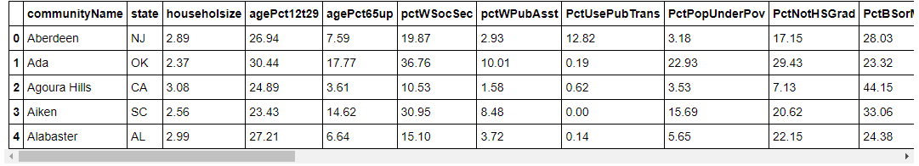
Exploratory Data Analysis
Narrowing Down the Data Set
Prior to any EDA (Exploratory Data Analysis), we removed any irrelevant features or features that contained race and ethnicity data narrowing down the feature set from 165 to 39
Next, we removed features that contained more than 30% null values and removed observations that were missing crime rate or education data and aggregated the data from zip code level back to the community level
This resulted in a final data set containing 1414 observations and 27 features
Final features include:
Family structure, Housing, Economics, education, and planned parenthood data
Sample of features in the final data set
Notes:
Prior to starting the exploratory data analysis, we had to remove some irrelevant features, and variables that contained race and ethnicity data.
This allowed us to narrow down the feature set from 165 variables to 39 variables. Next, we removed features that contained more than 30% null values and removed observations that were missing crime rate or education data and aggregated the data from zip code level back to the community level.
This resulted in the final data set of 1414 observation and 27 features.
The final data set contained features that describe family and community structure, housing and economic data, and finally education and planned parenthood related data. There is a sample of some of the features in the bottom of the screen.
For the Exploratory Data Analysis, we first visualized the crime rate distribution in a box plot and histogram that show that the data is skewed towards low crime rates.
Next, we looked at scatter plots of variables that describe the community and family structure vs crime rate and we can see that low percentage of youth in the population, high percentage of housing occupied, low percentage of population that is unemployed and high percentage of school funding that is coming from local sources are all correlated with low crime rates.
Based on this first glimpse into the data we hypothesize that strong family and community structure is the main drive for low crime rates.

Slide 6
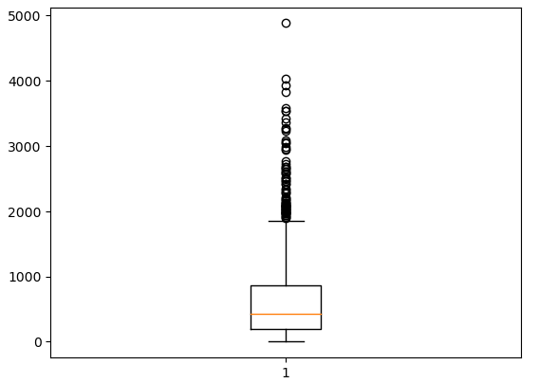
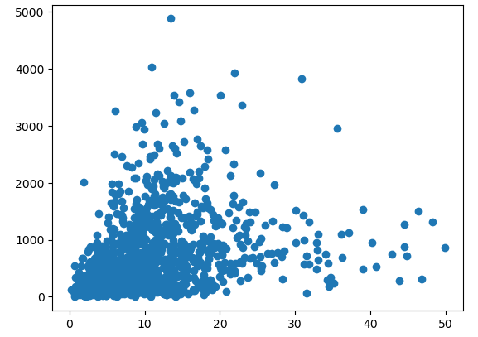
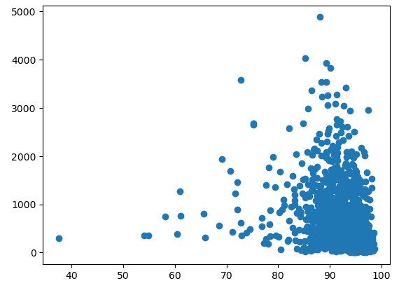
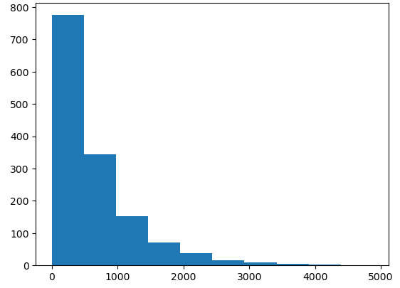
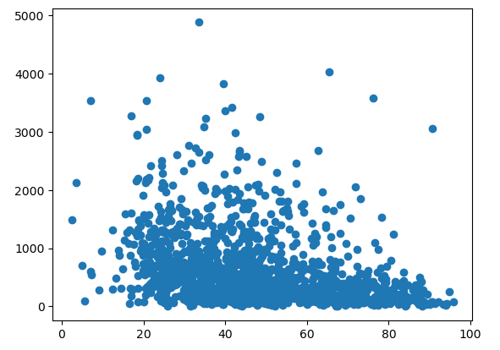
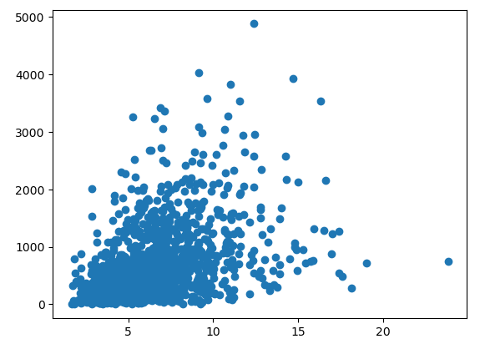
Exploratory Data Analysis
Normalized Crime Rate
Selected Features vs Crime Rate
Crime Rate Box Plot
Our overall hypothesis is that family and community structure is highly correlated with crime rates
% of population less than 9th grade
% of housing occupied
Crime Rate Histogram
% of school funding from local sources
% of population unemployed
Notes:
Our project focused around the problem of violent crime in US communities.
We began this project with a hypothesized life cycle.
We held the belief that government policy served as the origin point for the most influential variables that contribute to violent crime.
We pose the idea, that different stances on government policy, thereby dictating the allocation of government funding, directly create the overall environment that makes up a community.
These environmental variables serve as the seeds that grow the socio-economic climate that is a community.
Healthy seeds, dictated by informed policy, create a prosperous community.
Where as unhealthy seeds lead to a hostile environment, thereby breeding crime.
The overall goal of our project was to uncover the most important factors of policy that a government(local or federal) could influence.
We gathered data and used machine learning methodologies, with the intent of creating a tool that would inform policy makers on the optimum stance to exercise on various issues.
With an emphasis on understanding the relationship of these issues and crime(inference), as opposed to one of predicting the rate of crime under circumstantial input

Slide 7
Linear Regression
Prior to any modeling process, split data into 70% train and 30% test sets
Linear Regression has the benefits of simple procedures and easy interpretation
Linear Regression with Greedy algorithm applied:
1. Linear Regression
2. Forward feature selection + Linear Regression
3. Backward feature elimination + Linear Regression
Notes:
In other words, there would be around 420 datapoints for the model validation.
We used 3 different approaches, and we also applied greedy algorithm as listed

Slide 8

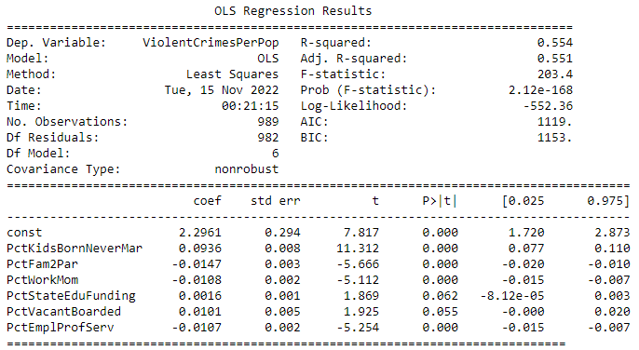
Linear Regression
Linear Regression:
Fit linear regression model including ALL features in the train set, selected 6 variables based on 95% confidence interval
Validation results: R-squared=0.55, Adjusted R-squared=0.55, MSE=0.138
Final Linear Regression model report
Notes:
Let's start with the first one. We trained the linear regression model including all independent variables in the train set and we were able to select the top 6 important features based on the 95% CI. Then we trained the model again with only those variables, and compared the final predictions in the test set to the response observations, the mean squared error was actually as low as 0.138.

Slide 9
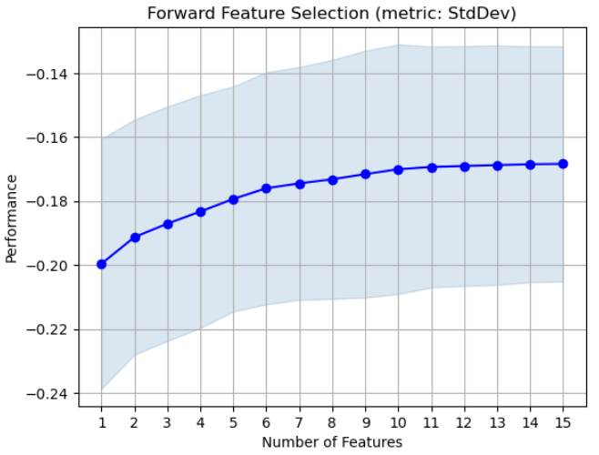
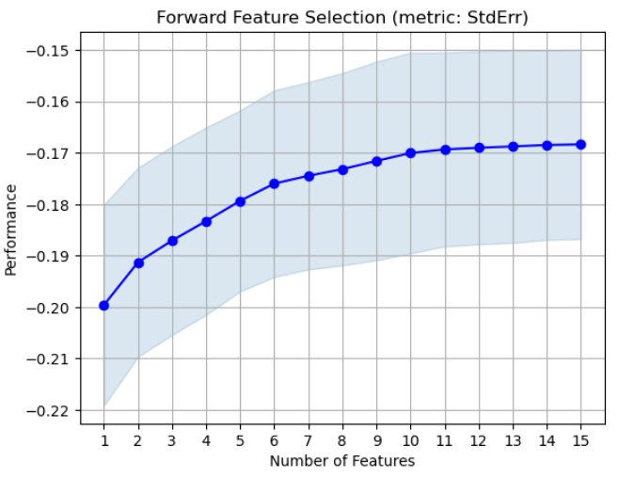
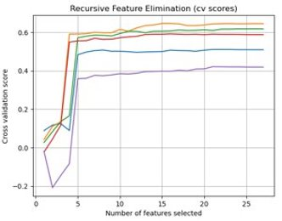
Linear Regression with Greedy Algorithm
Forward Selection + Linear Regression:
Selected 10 variables from 5-fold cross-validated forward selection
Trained linear regression on the 10 selected variables with 95% CI
Validation results: R-squared=0.57, Adjusted R-squared=0.56, MSE=0.142
Backward Elimination + Linear Regression
Remained 12 variables from 5-fold cross-validated backward elimination
Trained linear regression on the 12 variables, output report format same as linear regression with 95% CI
Validation results: R-squared=0.575, Adjusted R-squared=0.571, MSE=0.142
Forward Selection performance by standard deviation and standard error
Backward Elimination 5-fold
cross-validation scores
Notes:
Then we tried to see whether the forward selection and backward elimination were able to improve the results or not. We kept certain amount of features from both methods based on their corresponding metrics as presented on the slide, and fitted a linear regression model respectively on those selected variables also with a 95% CI, we found that even though both models could explain slightly more data than linear regression alone according to the higher r-squares, they might be subject to finding the local optimal solution and incurred to more errors.

Slide 10
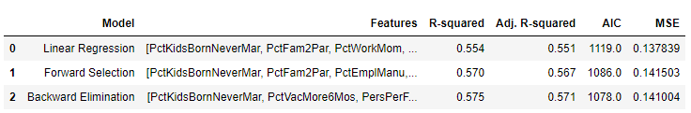
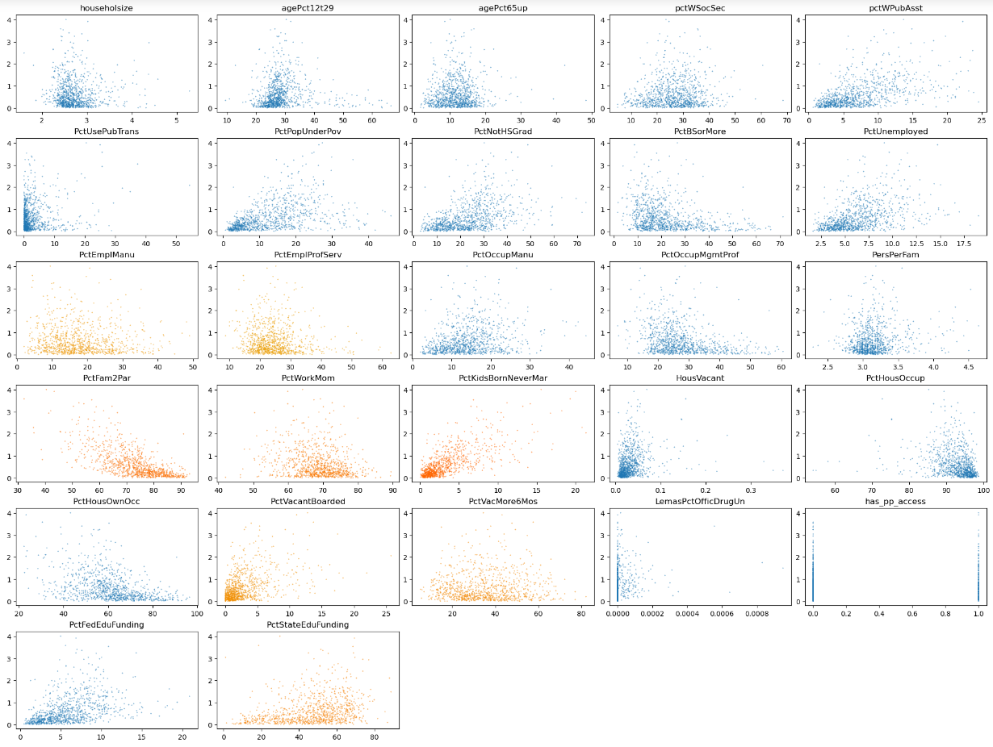

Linear Regression with Greedy Algorithm
Model Comparisons:
Linear Regression: R-squared=0.55, MSE=0.138
Forward Selection: R-squared=0.57, MSE=0.142
Backward Elimination: R-squared=0.575, MSE=0.141
Conclusion based on 3 models:
Linear Regression alone
Greedy Algorithm might suffer from finding local optimal solution that cannot explain data effectively
Model metrics comparisons
Scatterplot
gradience of oranges show feature hierarchy
Notes:
To sum up on the first part, all models seem to share some common important features. We picked linear regression alone to be the winner in this group because the results were only slightly differnt and we were more concerned about the mean squared errors

Slide 11
Decision Tree
Potentially better at predictions/ better fit to the data while still having strong interpretability
3 tree models:
1. All features, default hyperparameters
2. Feature selection, default hyperparameters
3. All features, tuned hyperparameters

Slide 12
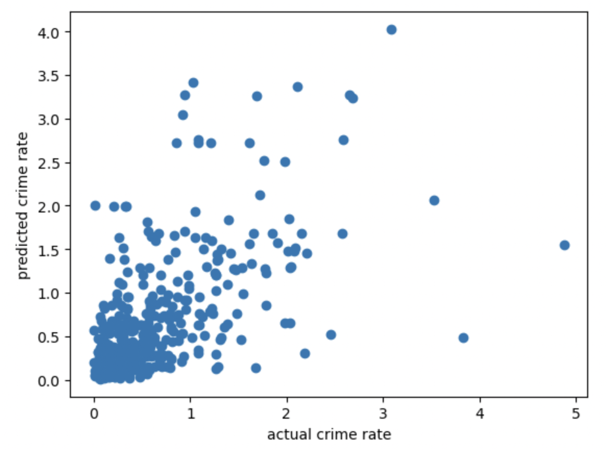
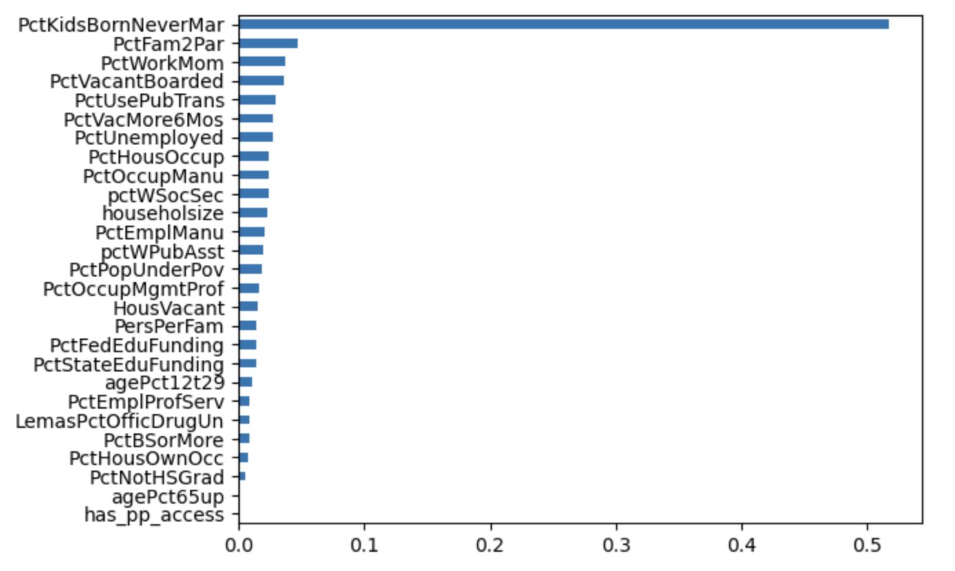
Decision Tree with Default Hyperparameters
Model 1:
Split dataset into same train/ test sets that were used for the linear regression
Fit tree including ALL features
Evaluated model by looking at difference between predicted and actual response in test set: MSE of 0.34
Model 2:
Similar approach, but used ExtraTreesRegressor for feature selection
Modeled using the top 5 features based on importance and achieved a slightly lower MSE of 0.31
In both models, the top two features were the same (PctKidsBornNeverMar, PctFam2Par)
Both of these trees were quite deep and difficult to interpret
Model 1 predicted vs actual
Model 1 feature importance

Slide 13
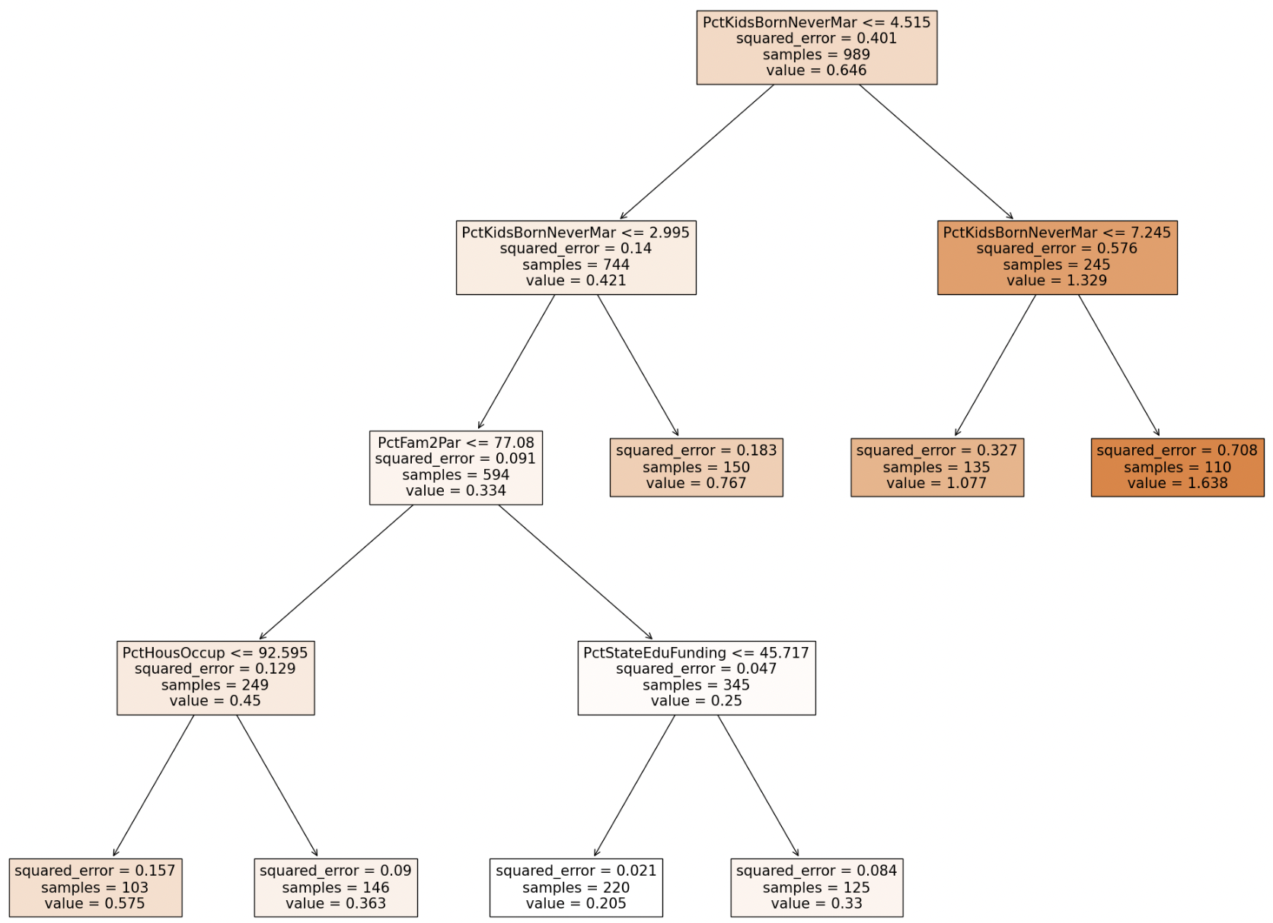
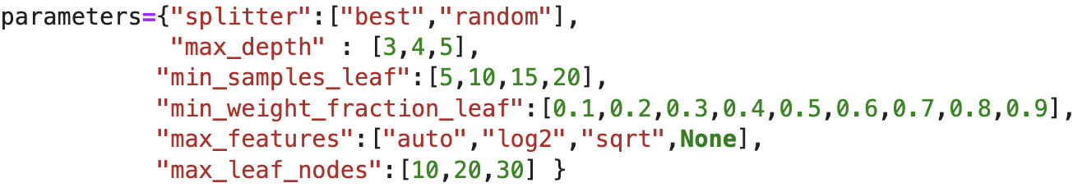
Decision Tree with Tuned Hyperparameters
Model 3:
Initialized hyperparameter ranges for tuning
Performed a grid search to find the optimal set of parameters
Fit the model on the full feature set using the tuned hyperparameters
This model did the best in terms of prediction accuracy: MSE of 0.19
Most important features:
PctKidsBornNeverMar
PctFam2Par
PctHousOccup
PctStateEduFunding

Slide 14
Final Model
Ultimately decided on the following linear regression model:
ViolentCrimesPerPop = 2.2961 + 0.0936 * PctKidsBornNeverMar – 0.0147 * PctFam2Par – 0.0108 * PctWorkMom + 0.0016 * PctStateEduFnding + 0.0101 * PctVacantBoarded – 0.0107 * PctEmplProfServ
Rationale:
Evaluation metric: lowest MSE
Most straightforward to interpret, explain, and predict
Drawbacks:
multicollinearity
Prone to noise/ overfitting

Slide 15
Business Recommendation & Suggested Next Steps
"Creating a tool for governments to use to INFORM their policy"
Legend:
(-) negative relationship with Violent Crime Rate
(+) Positive Relationship with Violent Crime Rate
Proposed Further Research​:
Family Structure
Percentage of Families with two Parents (-)
Education
Percent State Education Funding (+)
Presentation & Loitering
Percentage of kids born with parents never married (+)
Percentage of Vacant houses boarded up (+)
Working Class Health
Percentage over 16 employed (-)
Percentage of Working Mothers (-)
Methods for establishing strong community bonds
Factors influencing couple with kids getting married
Highschool Work Study & Apprenticeship Programs Effectiveness
Impact of vacant homes on property value
Notes:
As stated previously, our focus of this project was on creating a tool for governments to use to inform their policy making on factors that could influence communities and thereby crime rates.
A few important notes must be discussed before we outline our contextual interpretation of these variables.
One:
We must again highlight the word "INFORM", understanding the relationships of influence can only help you choose a policy or program based on their known effects, but does not choose for you.
Two:
Our project is not trying to evaluate causation. Therefore our business suggestions do not imply that.
Three
Professional understanding and context is required to accurately interpret the model and come up with the best solutions.
We broke down our 6 variables into 4 broader categories that we believe policy should be focused around.
Family Structure
While the government can't mandate family structure it can influence it, especially at the local level.
Here we would recommend increasing funds into planned parent hood, and sexual education.
Education
Our suggestion is local governments emphasize programs that try to increase public buy-in to the community.
Creating the idea of investing in themselves, and establishing the desire to give back and build stronger bonds amongst their local peers.
Presentation and Eliminating Empty Space
Vacant homes can become an unguarded location for criminal activity
We propose emphasizing policy to clean up the presentation of communities and re-purpose vacant spaces.
https://case.edu/socialwork/sites/case.edu.socialwork/files/2018-10/vacant_distressed_props_comm_health_safety.pdf
Working Class Health
We recommend emphasizing policy and programs that create work opportunities and training for single mothers, and young teenagers.
Thereby stimulating the local economy, creating role models in the family structure and empowering women, and eliminating downtime of youth
In Conclusion:
We encountered many different challenges throughout the project.
It revealed to the team the real level of detail and effort that must be put into such a complex problem of this nature.
Our project can only serve as a template for another to dedicate time and gather “hard” real world conclusions after extensive research.
As stated previously, our focus of this project was on creating a tool for governments to use to inform their policy making on factors that could influence communities and thereby crime rates.
This means understanding the relationship between the variables and crime, not necessarily an accurate prediction of the crime rate.
As we discussed, these are the variables that our final model has concluded to be the most influential variables.
Variable Descriptions
percentage of kids born to parents never married
percentage of families (with kids) that are headed by two parents
percentage of moms of kids under 18 in labor force
percent of vacant housing that is boarded up
-PctEmplProfServ
percentage of people 16 and over who are employed in professional services
Original Schema: https://archive.ics.uci.edu/ml/datasets/communities+and+crime

Slide 16
Research and Work Cited
Abdul Jalil, M. @, Mohd, F., & Mohamad Noor, N. M. (2017). A comparative study to evaluate filtering methods for crime data feature selection. Procedia Computer Science, 116, 113–120. https://doi.org/10.1016/j.procs.2017.10.018
Branas, Charles & Rubin, David & Guo, Wensheng. (2013). Vacant Properties and Violence in Neighborhoods. ISRN public health. 2012. 246142. 10.5402/2012/246142.
Center on Urban Poverty and Community Development. (2017, June 5). Exploring the relationship between vacant and distressed properties and ... Case Western Reserve University. Retrieved November 18, 2022, from https://case.edu/socialwork/healthcounseling/sites/case.edu.socialwork/files/2018-10/vacant_distressed_props_comm_health_safety.pdf
Durlauf, S. N., Navarro, S., & Rivers, D. A. (2010). Understanding aggregate crime regressions. Journal of Econometrics, 158(2), 306–317. https://doi.org/10.1016/j.jeconom.2010.01.003
John J. Donohue, Steven D. Levitt, The Impact of Legalized Abortion on Crime over the Last Two Decades, American Law and Economics Review (2020)
MARKOWITZ, F.E. (2006), PSYCHIATRIC HOSPITAL CAPACITY, HOMELESSNESS, AND CRIME AND ARREST RATES. Criminology, 44: 45-72. https://doi.org/10.1111/j.1745-9125.2006.00042.x
Hamid Noghanibehambari, School Finance Reforms and Juvenile Crime, American Law and Economics Review, Volume 24, Issue 1, Spring 2022, Pages 1–86, https://doi.org/10.1093/aler/ahac001
Stephen Machin, Olivier Marie, Sunčica Vujić, The Crime Reducing Effect of Education, The Economic Journal, Volume 121, Issue 552, May 2011, Pages 463–484, https://doi.org/10.1111/j.1468-0297.2011.02430.x
Ven, T. V., & Cullen, F. T. (2004). The Impact of Maternal Employment Serious Youth Crime: Does the Quality of Working Conditions Matter? Crime & Delinquency, 50(2), 272–291. https://doi.org/10.1177/0011128703253165

